Slide 1

Artificial Intelligence
Introduction
Modified slides of CS-188 Berkeley University

Slide 2
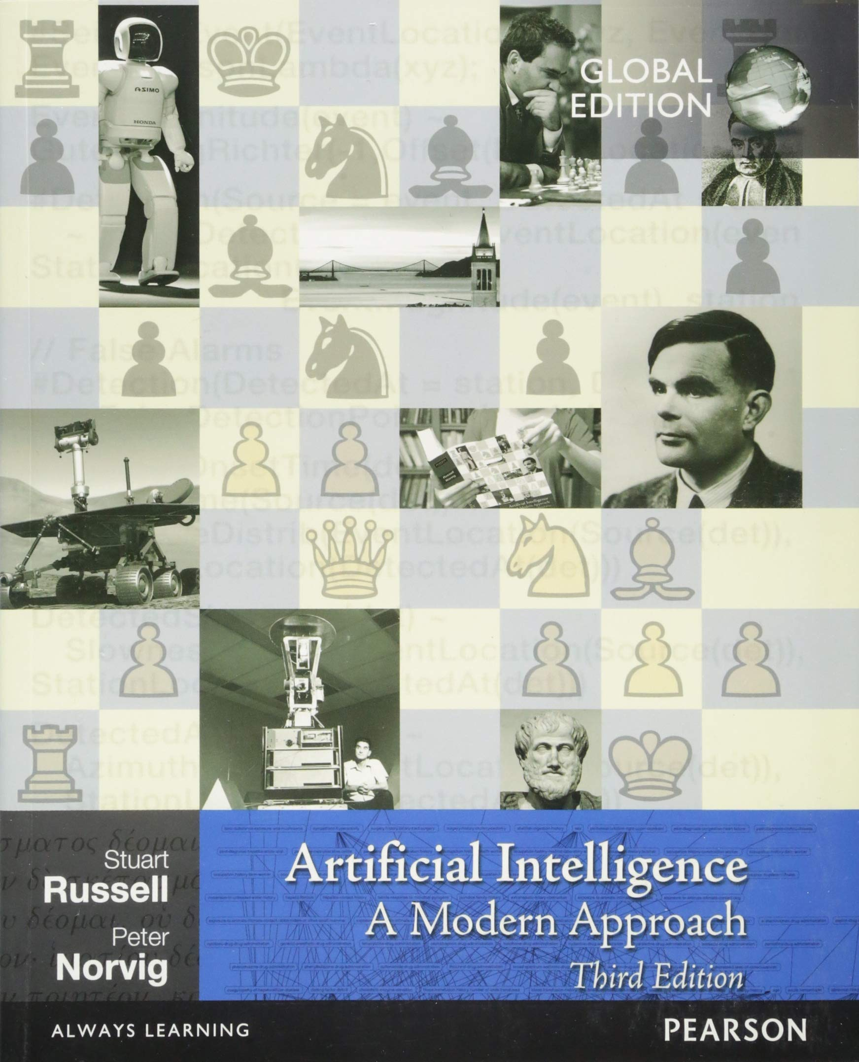
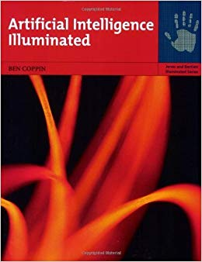
Recommended Books
Artificial Intelligence: A Modern Approach,
Russell & Norvig.
(https://faculty.psau.edu.sa/filedownload/doc-7-pdf-a154ffbcec538a4161a406abf62f5b76-original.pdf )
“Artificial Intelligence Illuminated”
Ben Coppin,
(http://futuresoft.yolasite.com/resources/Artificial%20Intelligence%20Illuminated.pdf)

Slide 3
Recommended Books
“Artificial Intelligence – Structures and Strategies for Complex problem solving”, George F. Luger, Pearson International Edition, Sixth edition, 2009.
“Artificial Intelligence: A new synthesis” Nils Nilsson, Morgan Kaufmann, 1998
UC Berkeley CS188 Intro to AI (http://ai.berkeley.edu/home.html)

Slide 4
Grading (Tentative)
ITEM | WEIGHTAGE
Quizzes | 15 %
Assignments | 15 %
Class Participation | 5%
Mid Term | 20 %
Final Term | 45 %
Total | 100

Slide 5
Logistics
Quiz may be un-announced.
Read the book
Plagiarism – Write your own Solution
Deadline of the assignments will not be extended
No Late submissions will be accepted.

Slide 6
Other Announcements
Email address:
  Rabia.tehseen@ucp.edu.pk
Office:
  A Block, 2nd Floor, Office F201 , Cabin 3
Course Coordinator
  Dr. Mohsin Ashraf

Slide 7
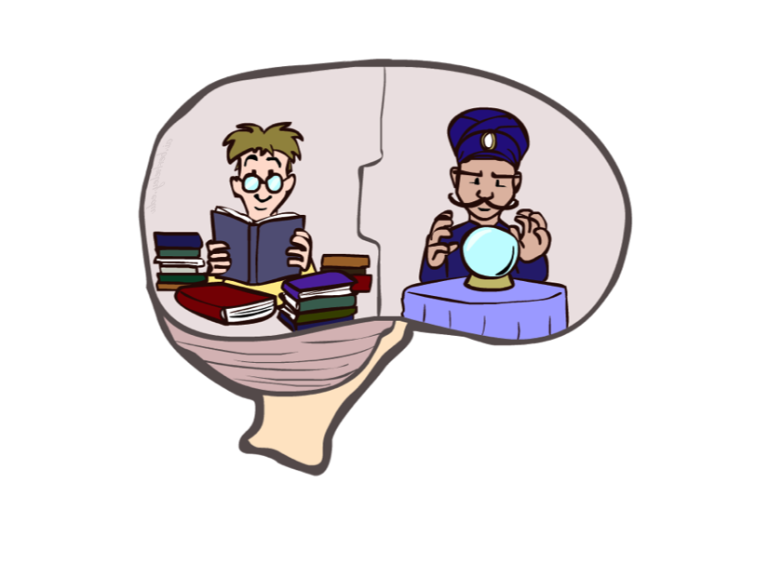
Course Topics
Part I: Solving Problems by Searching
  Fast search / planning
  Constraint satisfaction
  Heuristics
  Adversarial and uncertain search
Part II: Knowledge, reasoning, and Planning
  Reasoning agents
  Propositional logic
  Predicate logic
  Knowledge-based systems
Part III: Machine Learning
  Classification
  Clustering
  Neural Networks

Slide 8
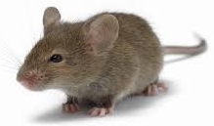
Question
  Is this mouse intelligence?
    It depends on context
    Route planning (Yes)
    Mathematical problem solving (No)
Is Google Intelligent?
  Task specific intelligence
Are humans intelligent?

Slide 9
Why AI?
Two main goals of AI:
  To create useful “smart” programs able to do tasks that would normally require a human expert
  To understand human intelligence better as we test theories of human intelligence by writing programs which emulate them

Slide 10
What is Intelligence?
Ability of problem solving
Ability to think, plan and schedule
Efficient memory and information manipulation
Ability to tackle ambiguous and fuzzy problems
Ability to understand and perceive

Slide 11
Artificial Intelligence
“Study of computations that make it possible to perceive, reason and act.”
Branch of Science which deals with helping machines to find solutions to complex problems in a more human-like fashion
In short, putting human intelligence into machines

Slide 12

Artificial Intelligence
What is Intelligence ??
Perceive
Understand
Remember
Think
Reason
Learn from Experience
Adapt to the new Situation
Problem Solving

Slide 13
Humans Vs Machines
Humans | Machines
Symbolic calculation Natural language understanding Not very precise Knowledge Generalize from examples Deal with noisy inputs | Numeric calculation Machine Language Precise Data Cannot generalize Cannot deal with noise

Slide 14
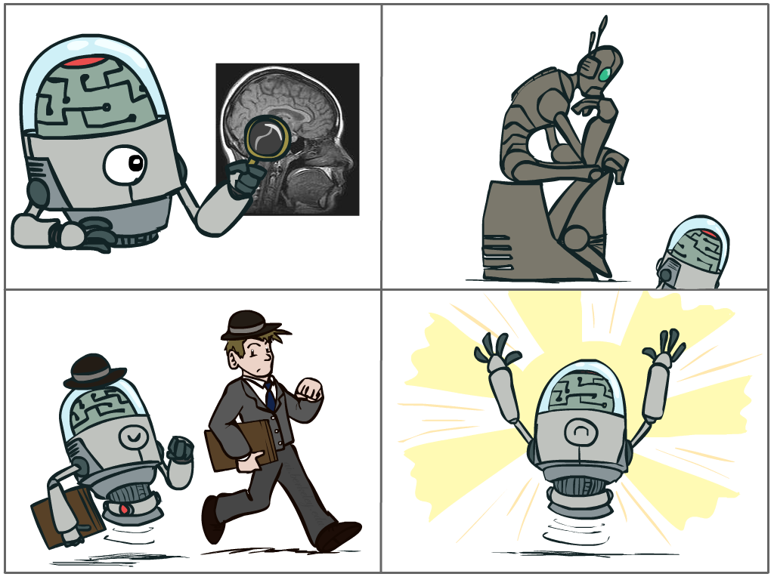
What is AI?
The science of making machines that:
Think like people
Think rationally
Cognitive modeling approach
Laws of thought approach
Act like people
Act rationally
Turing Test
approach
Rational agent approach
Notes:
Top left: Think like people --- cognitive science, neuroscience
Bottom left: act like people --- actually very early definition, dating back to Alan Turing --- Turing test; problem to do really well you start focusing on things like don’t answer too quickly what the square root of 1412 is, don’t spell too well, and make sure you have a favorite movie etc. So it wasn’t really leading us to build intelligence
Think rationally – long tradition dating back to Aristotle --- but not a winner, because difficult to encode how to think, and in the end it’s not about how you think, it’s about how you end up acting

Slide 15
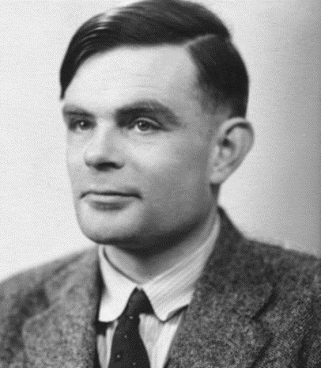
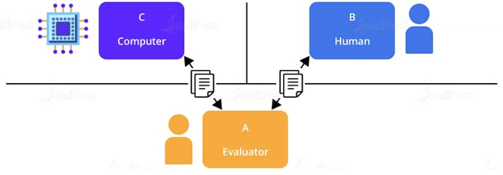
Acting Humanly:
Turing Test
Alan Turing (1950) “Computing machinery and intelligence”.
A computer passes the test if a human interrogator, after posing some written questions, cannot tell whether the written responses come from a person or from a computer.

Slide 16
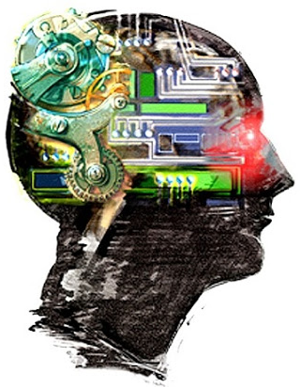
Thinking Humanly:
The cognitive modeling approach
For that we must determine how humans think.
Need to get inside the actual workings of human minds.
Three ways to do this:
Through introspection
  trying to catch our own thoughts
  as they go by
Through psychological experiments
  observing a person in action
Through brain imaging
  observing the brain in action.

Slide 17
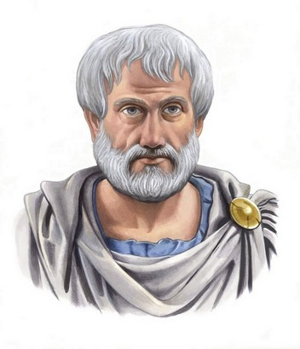
Thinking Rationally:
Laws of Thought
Aristotle: First to codify “right thinking”
Several Greek schools developed various forms of logic:
  Notation and rules of derivation for thoughts
  Propositional logic, Predicate logic, etc.
Always yield correct conclusions when given correct premises
  E.g. “Socrates is a man; all men are mortal; therefore, Socrates is mortal.”
These laws of thought were supposed to govern the operation of the mind; their study initiated the field called logic.

Slide 18
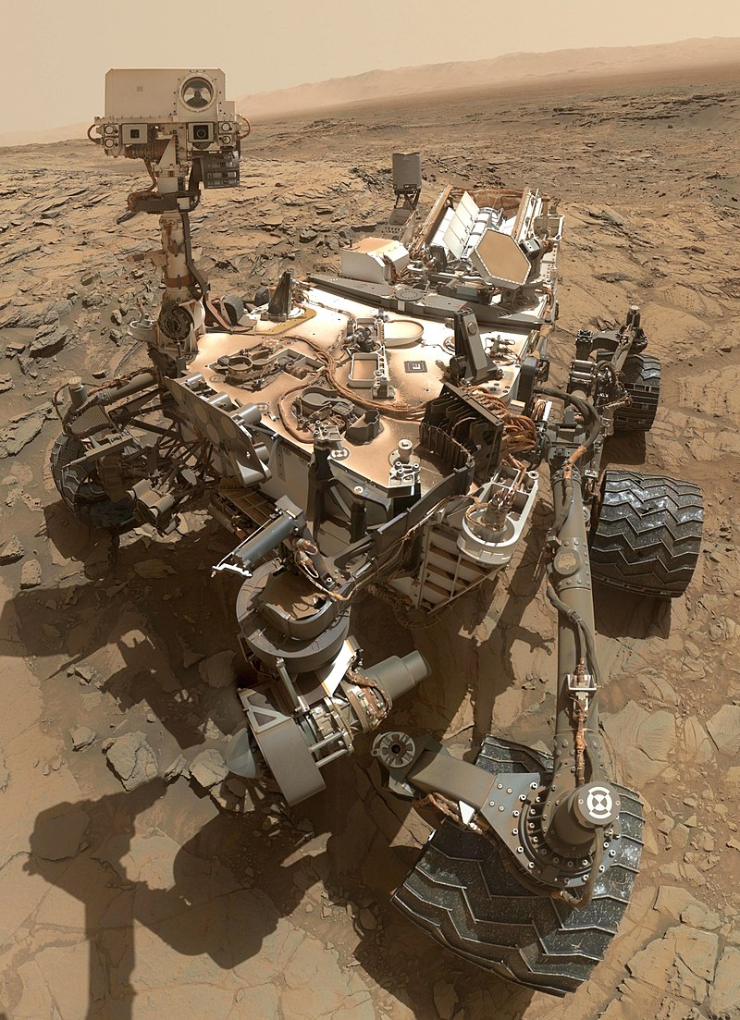
Acting rationally:
Rational agent
An agent is something that acts.
All computer programs do something, but computer agents are expected to do more:
  Operate autonomously,
  Perceive their environment,
  Persist over a prolonged time period
  Adapt to change, and create and pursue goals.
  Make correct inferences
Curiosity (rover)
Notes:
launched on Mars in 2011; whether the planet could have ever supported microbial life.

Slide 19
Acting rationally:
Rational agent
A rational agent is one that acts so as to achieve the best outcome or, when there is uncertainty, the best expected outcome.
Rational behavior: doing the right thing
The right thing: the optimal (best) thing that is expected to maximize the chances of achieving a set of goals, in a given situation

Slide 20
This course is about designing
rational/intelligent agents
Build REPRESENTATIONS that
support MODELS targeted at
THINKING PERCEPTION ACTION

Slide 21
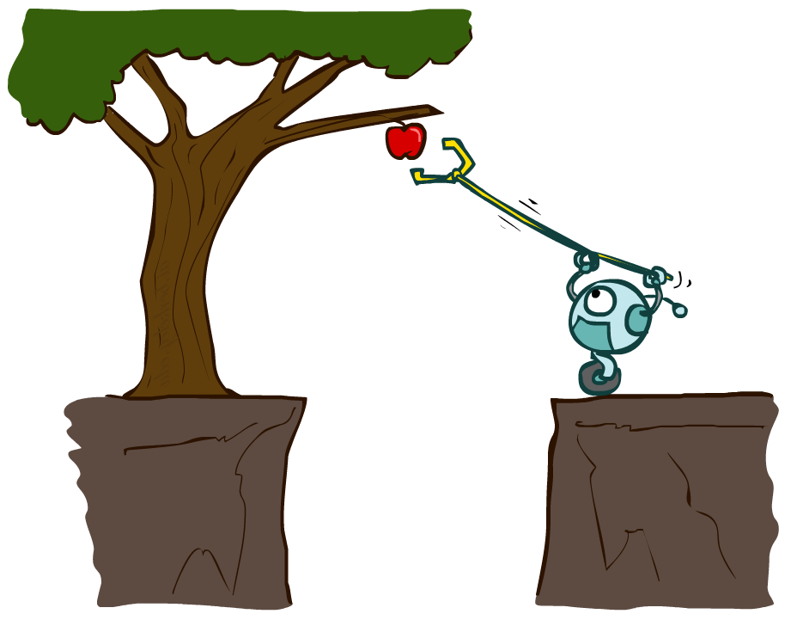
Designing Rational Agents
An agent is an entity that perceives and acts.
A rational agent selects actions that maximize its (expected) utility.
Characteristics of the percepts, environment, and action space dictate techniques for selecting rational actions
This course is about:
  General AI techniques for a variety of problem types
  Learning to recognize when and how a new problem can be solved with an existing technique
Sensors
Agent
Percepts
Environment
?
Actuators
Actions

Slide 22
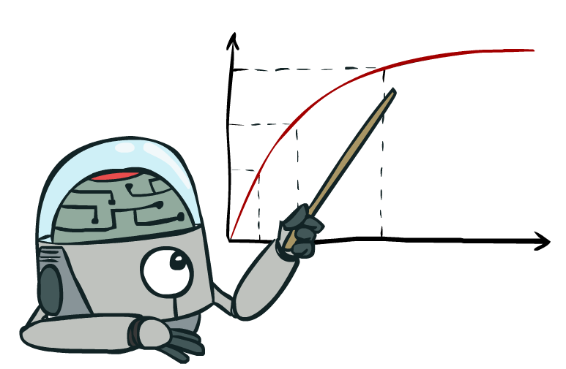
Rational Decisions
We’ll use the term rational in a very specific, technical way:
Rational: maximally achieving pre-defined goals
Rationality only concerns what decisions are made (not the thought process behind them)
Goals are expressed in terms of the utility of outcomes
Being rational means maximizing your expected utility
Notes:
Goals are expressed in terms of the utility of outcomes : mean to maximize overall utility in every aspect possible

Slide 23
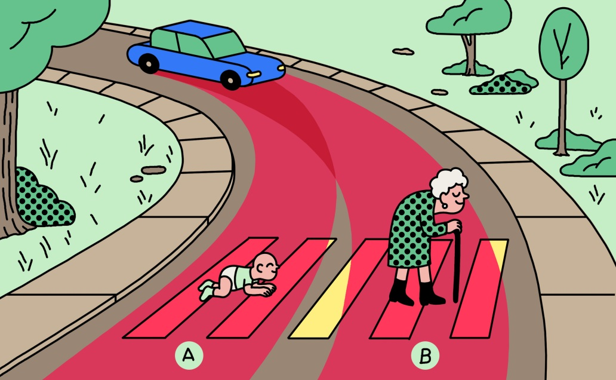

Slide 24
Approaches to AI
Strong AI
  Strong AI aims to build machines that can truly reason and solve problems who is self aware and whose overall intellectual ability is indistinguishable from that of a human being.
    Human-Like
Weak AI
  Weak artificial intelligence (weak AI), also known as narrow AI, is artificial intelligence that is focused on one narrow task.
  Deals with the creation of some form of computer-based artificial intelligence that cannot truly reason and solve problems, but can act as if it were intelligent.
  Siri is a good example of narrow intelligence.

Slide 25
Quick Quiz
To what extent are the following computer systems instances of artificial intelligence:
  Supermarket bar code scanners.
  Web search engines.
  Voice-activated telephone menus.

Slide 26
Applications of AI
Game playing
Computer vision
Natural language processing
Diagnosis systems
Control
Optimisation
Robotics

Slide 27
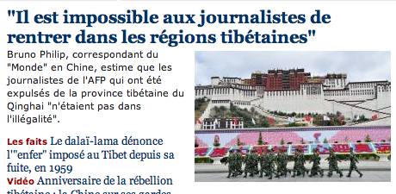
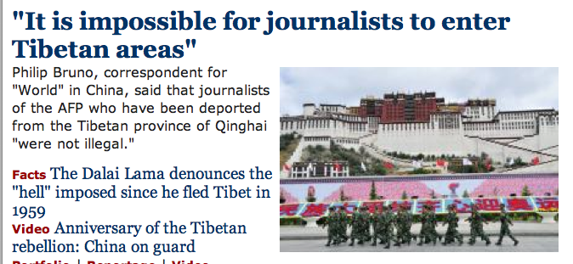
Natural Language
Speech technologies (e.g. Siri)
  Automatic speech recognition (ASR)
  Text-to-speech synthesis (TTS)
  Dialog systems
Language processing technologies
  Question answering
  Machine translation
  Web search
  Text classification, spam filtering, etc…

Slide 28


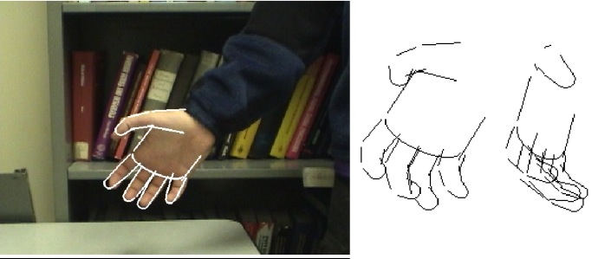

Vision (Perception)
Object and face recognition
Scene segmentation
Image classification (say hand pic as hand)

Slide 29
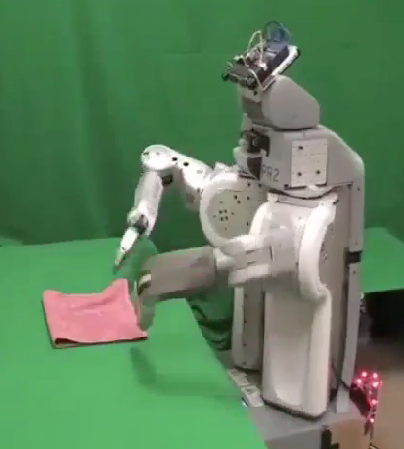
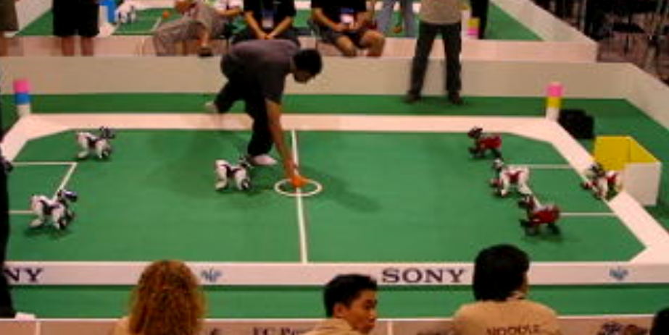
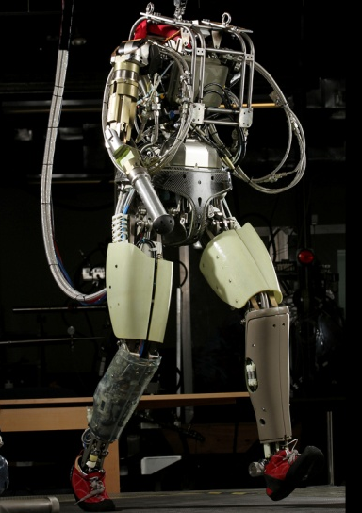
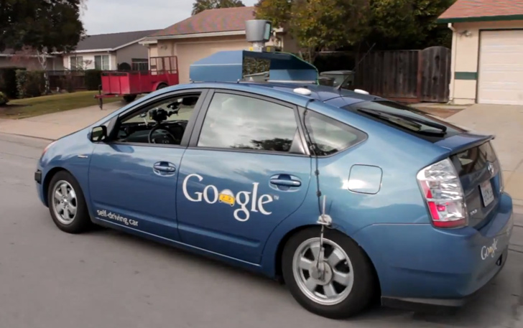
Robotics
Robotics
Technologies
  Vehicles
  Rescue
  Soccer!
  Lots of automation…

Slide 30


Decision Making
  Applied AI involves many kinds of automation
    Scheduling, e.g. airline routing, military
    Route planning, e.g. Google maps
    Medical diagnosis
    Web search engines
    Spam classifiers
    Automated help desks
    Fraud detection
    Product recommendations
    … Lots more!
Notes:
All applications can be thought of as decision making or useful sub-components of decision making

Slide 31
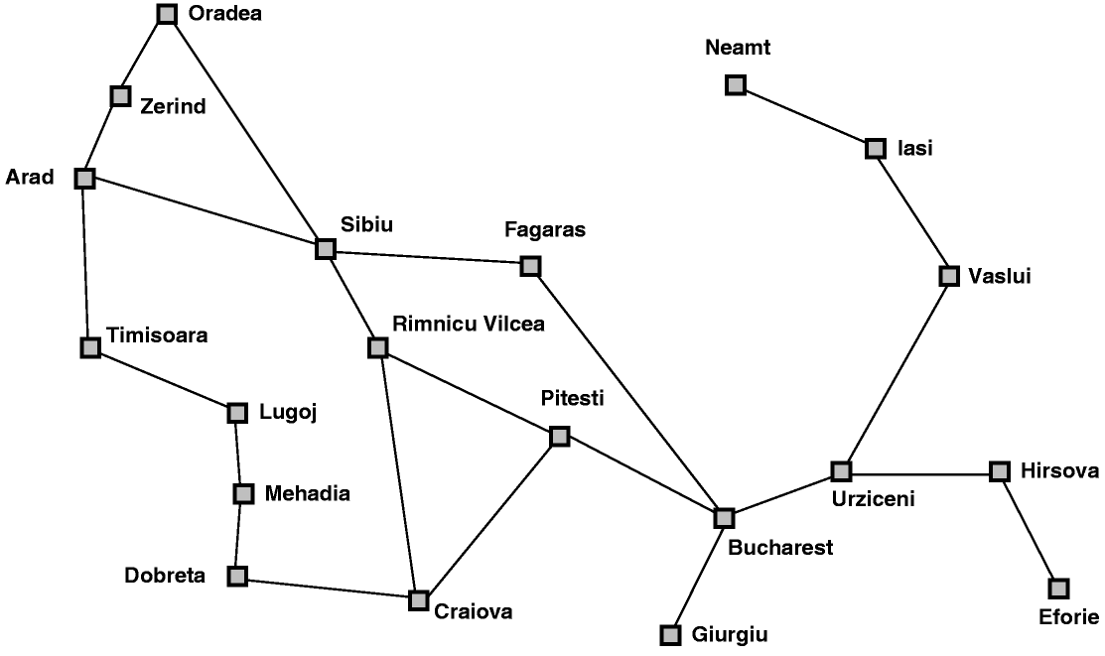
AI Topics: A Quick Introductory Overview
Classic AI search problems: Map searching (navigation)

Slide 32
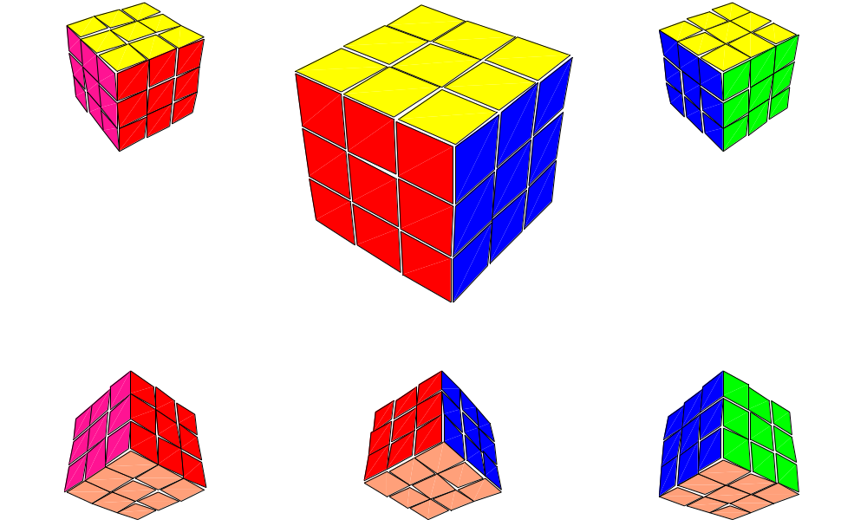
AI Topics: A Quick Introductory Overview
Classic AI search problems
  3*3*3 Rubik’s Cube

Slide 33
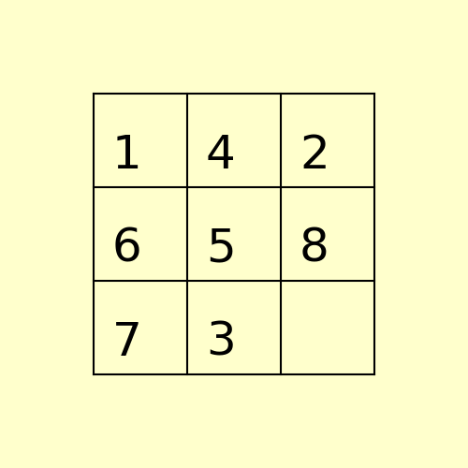
Classical AI Search Problems
8-Puzzle
1
4
2
1
2
3
6
5
8
4
5
6
7
3
7
8

Slide 34

Classical AI Search Problems

Slide 35
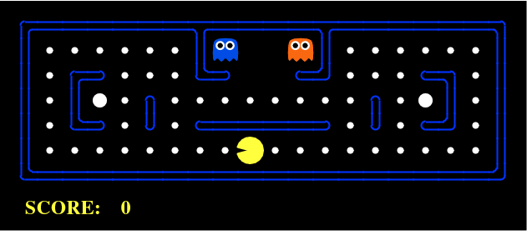
Classical AI Search Problem
Pac-Man

